Slide 1

MexE 406
Robotics 1
Engr. Mikko A. De Torres
Mechatronics Engineer
Department of Electronics Engineering
Batangas State University || College of Engineering

Slide 2
“Types”
Engr. Mikko A. De Torres
Mechatronics Engineer
Department of Electronics Engineering
Batangas State University || College of Engineering

Slide 3
Motion Characteristics
Power Source
Control Methods
Orientation of Joints
Number of DOF

Slide 4
“Types: Motion Characteristics”
Engr. Mikko A. De Torres
Mechatronics Engineer
Department of Electronics Engineering
Batangas State University || College of Engineering

Slide 5
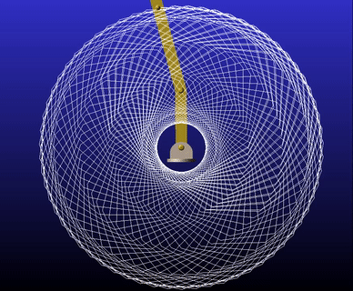
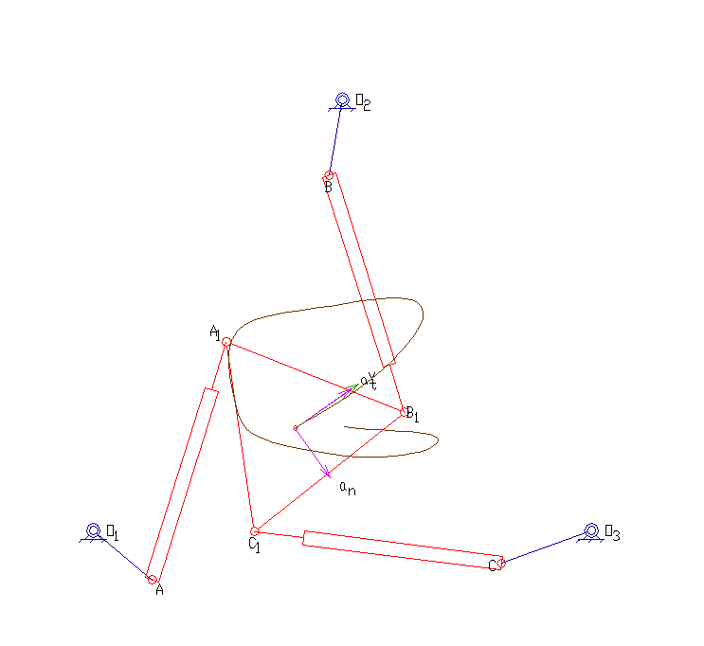
Types of Mechanical Manipulator based on Motion Characteristics
Planar manipulator: A manipulator is called a planar manipulator if all the moving links move in planes parallel to one another.
RR Planar Manipulator
Planar Delta Manipulator

Slide 6
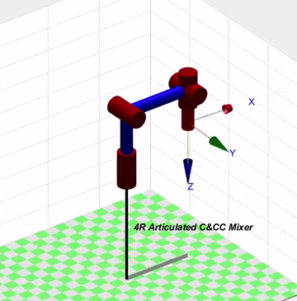
Types of Mechanical Manipulator based on Motion Characteristics
Spatial manipulator: A manipulator is called a spatial manipulator if at least one of the links of the mechanism possesses a general spatial motion.
Articulated Spatial Manipulator

Slide 7
“Types: Power Source”
Engr. Mikko A. De Torres
Mechatronics Engineer
Department of Electronics Engineering
Batangas State University || College of Engineering

Slide 8
Types of Mechanical Manipulator based on Power Source
Electrically powered: Robots driven by DC- or AC-servo motors are increasingly popular since they are cheap, clean and quiet.
Hydraulically powered: Hydraulic actuators are known for lifting heavy loads. However, the hydraulic robots tend to leak hydraulic fluid, require much more peripheral equipment and maintenance, and they are noisy.
Pneumatically powered: Pneumatic robots are inexpensive, unrivalled in their speed response and simple, but cannot be controlled precisely. As a result, pneumatic robots are limited in their range of applications.

Slide 9
“Types: Orientation of Joints”
Engr. Mikko A. De Torres
Mechatronics Engineer
Department of Electronics Engineering
Batangas State University || College of Engineering

Slide 10
Types of Mechanical Manipulator based on Control Methods
Non-servo robots: The earliest robots were non-servo robots. These robots are essentially open-loop devices whose movement is limited to predetermined mechanical stops, and they are useful primarily for materials transfer.
Servo robots: Servo robots use closed-loop computer control to determine their motion and are thus capable of being truly multifunctional, reprogrammable devices. Servo controlled robots are further classified according to the method that the controller uses to guide the end effector. The simplest type of robot in this class is the point-to-point robot.

Slide 11
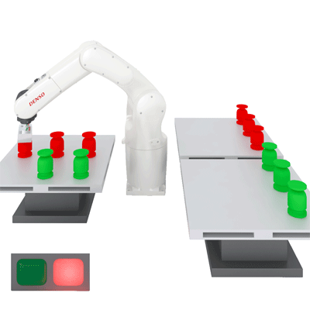
Types of Mechanical Manipulator based on Control Methods
Servo robots: - A point-to-point robot can be taught a discrete set of points but there is no control on the path of the end effector in between taught points. Such robots are usually taught a series of points with a teach pendant (handheld device). The points are then stored and played back.

Slide 12
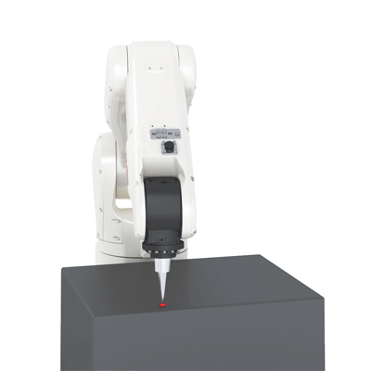
Types of Mechanical Manipulator based on Control Methods
Servo robots:
- In continuous path robots, on the other hand, the entire path of the end-effector can be controlled. For example, the robot end-effector can be taught to follow a straight line between two points or even to follow a contour such as a welding seam. In addition, the velocity and/or acceleration of the end-effector can often be controlled.

Slide 13
“Types: Control Methods”
Engr. Mikko A. De Torres
Mechatronics Engineer
Department of Electronics Engineering
Batangas State University || College of Engineering

Slide 14
Types of Mechanical Manipulator based on Orientation of Joints
Serial Manipulator (such as Cylindrical, Spherical, Articulated, SCARA & Cartesian)
each joint is attached to the previous actuated joint, or to ground
each actuated joint is attached to the next actuated joint or the end-effector

Slide 15
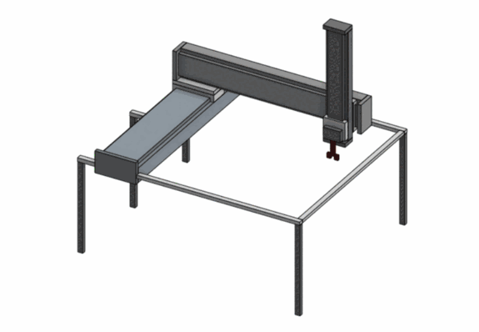
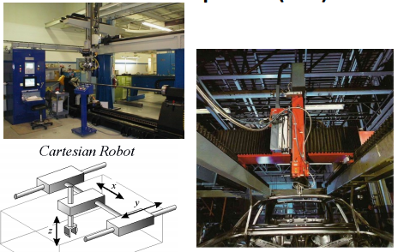
Types of Mechanical Manipulator based on Orientation of Joints
Cartesian Manipulator (PPP)
Notes:
CAD Drawings from:
BlockD_3203_21-22_Cartesian

Slide 16
Types of Mechanical Manipulator based on Orientation of Joints
Cartesian Manipulator (PPP)
• Also called rectangular or rectilinear or gantry.
• Robot has the ability to move its end effector to any position within the cube or cuboid workspace.
• The first three joints are prismatic.
• The joint variables are the Cartesian coordinates of the end-effector with respect to the base.
• the kinematic description of this manipulator is the simplest of all configurations
• Useful for transfer of materials, and table-top assembly

Slide 17
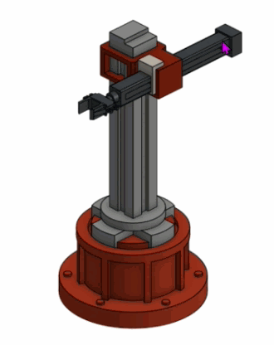
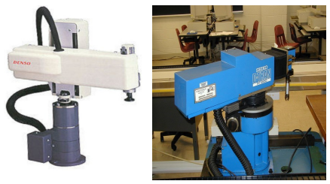
Types of Mechanical Manipulator based on Orientation of Joints
Cylindrical Manipulator (RPP)
Notes:
BlockE_3203_21-22_Cylindrical

Slide 18
Types of Mechanical Manipulator based on Orientation of Joints
Cylindrical Manipulator (RPP)
• The first joint is revolute and produces a rotation about the base, whereas the second and third joints are prismatic.
• The joint variables are the cylindrical coordinates of the end-effector with respect to the base.
• Its Rigid structure, allows large payloads and good repeatability.

Slide 19
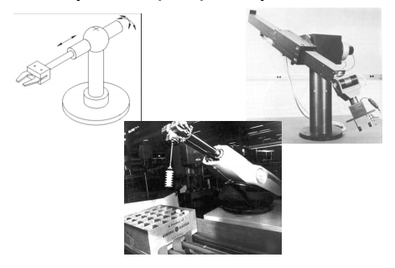
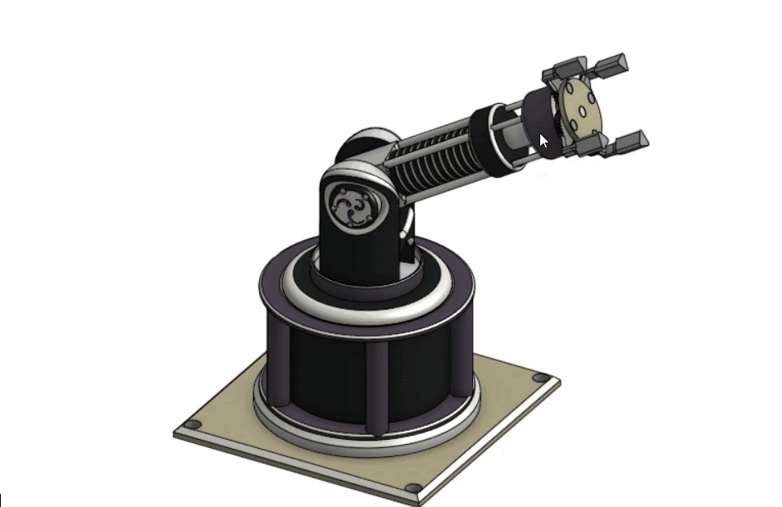
Types of Mechanical Manipulator based on Orientation of Joints
Spherical Manipulator (RRP)
Notes:
BlockE_3203_21-22_Spherical

Slide 20
Types of Mechanical Manipulator based on Orientation of Joints
Spherical (RRP) Manipulator
• It is a robot with two rotary joints and one prismatic joint.
• The spherical manipulator, also called polar manipulator, has three mutually perpendicular axes (has z0 , z1 , z2 mutually perpendicular).
• The joint variables are the spherical coordinates of the end-effector with respect to the base.
• Spherical manipulators have lost practicality in the workplace due to 6 axes articulated manipulators.

Slide 21
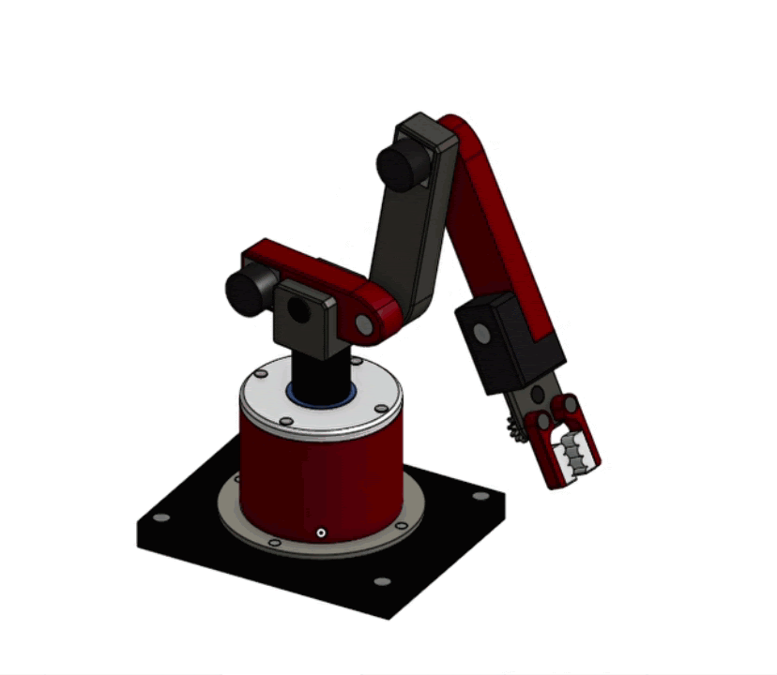
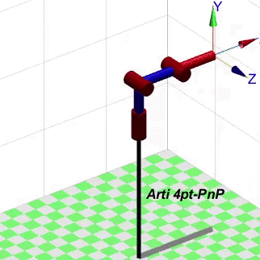
Types of Mechanical Manipulator based on Orientation of Joints
Articulated Manipulator (RRR)
Notes:
BlockD_3203_21-22_Articulated

Slide 22
Types of Mechanical Manipulator based on Orientation of Joints
Articulated Manipulators (RRR)
• The articulated manipulator is an industrial robot with rotary joints and is also called a revolute, or anthropomorphic manipulator.
• Articulated robots can range from simple two-jointed structures to systems with 10 or more interacting joints.
• Three revolute joints; the axes of second and third R joints are parallel, whereas the axis of first R joint is vertical.
• Relatively large movement freedom in a compact space.

Slide 23
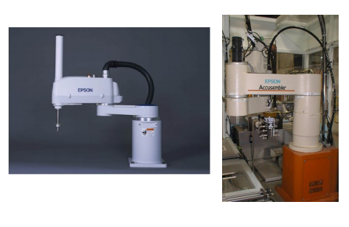
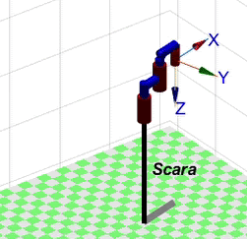
Types of Mechanical Manipulator based on Orientation of Joints
SCARA Manipulator (RRP and PRR)

Slide 24
Types of Mechanical Manipulator based on Orientation of Joints
SCARA Manipulator (RRP)
• SCARA is the short for Selective Compliant Articulated Robot for Assembly.
• It is RRP but the axes are parallel (parallel z0 , z1 , z2 ).
• Specially designed for assembly operations.
• The SCARA construction allow for precise work and quick assembly or packaging.

Slide 25
Types of Mechanical Manipulator based on Orientation of Joints
Parallel Manipulator
each actuated joint is attached both to ground and to the end-effector
There are 2 common types
Stewart or Gough Platform
Delta Manipulator

Slide 26
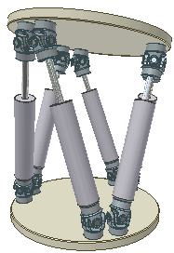
Types of Mechanical Manipulator based on Orientation of Joints
Parallel Manipulator
Stewart or Gough Platform
Gough invented it in 1947. Later on 1965, Stewart suggested that this type of manipulators are good type to use for flight simulators. Until now it is use for flight simulations.
The platform itself is the end effector.
The joints mostly consist of Prismatic Linear Joints and Hooke or Spherical joints

Slide 27
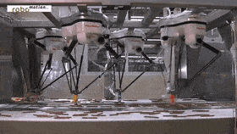
Types of Mechanical Manipulator based on Orientation of Joints
Parallel Manipulator
b. Delta Robot
mainly used in applications where the robot is picking products in groups and placing them in a container or in an assembly pattern
Revolute joints are normally used for the joints.

Slide 28
Knowledge Check:
https://www.baamboozle.com/game/632698
Notes:
https://www.baamboozle.com/game/632698

